Slide 1

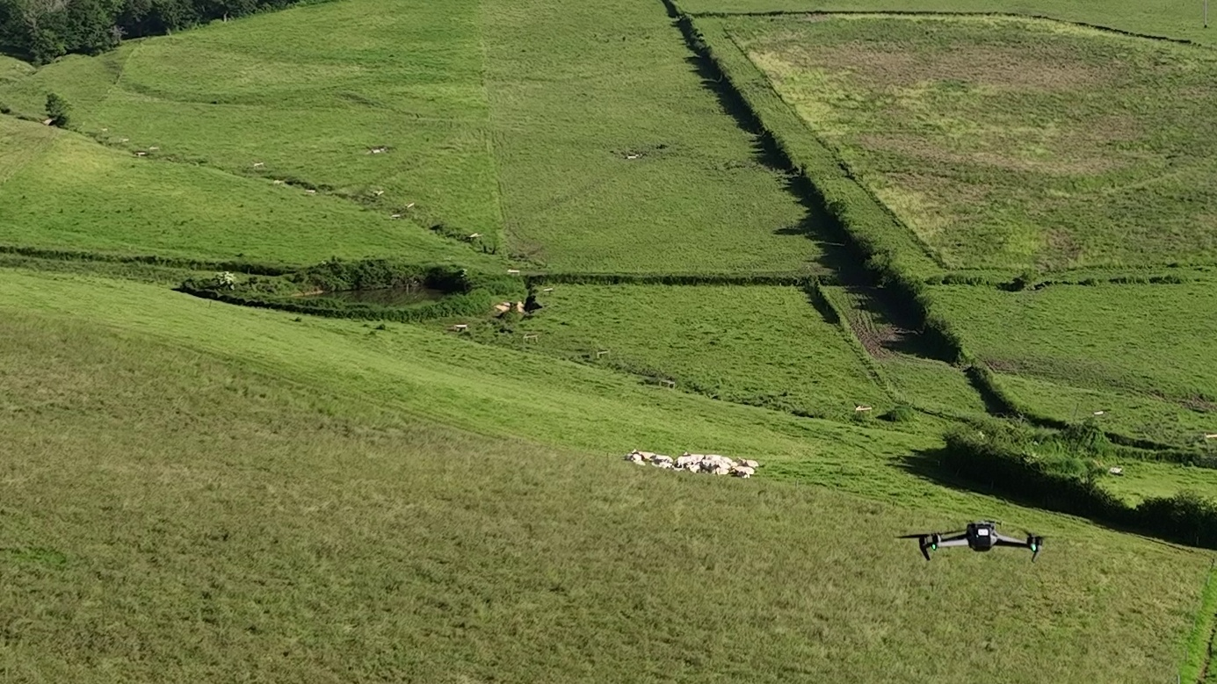



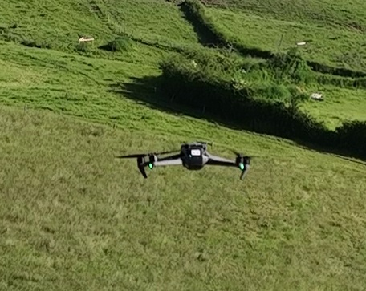
Technical day :
The drone, an aid for monitoring herds

Slide 2




Introducing the speakers
The ICAERUS project team
Hosted in the Limousin region by
Supported by

Slide 3
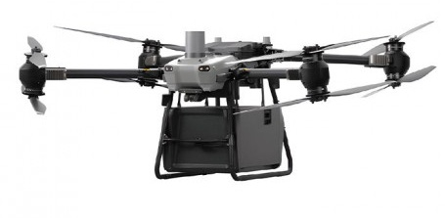
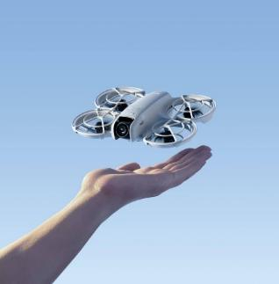
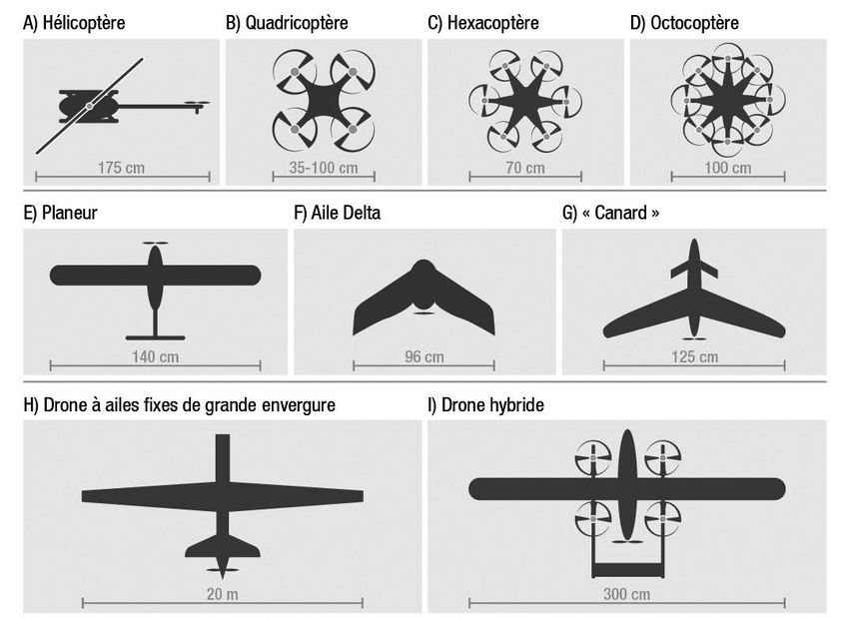
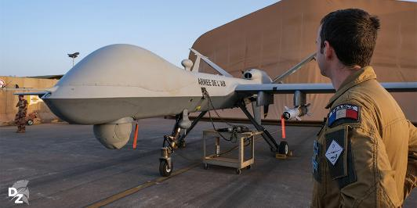
What is a drone?
A drone is defined as an aircraft with no crew on board, and so can bring together many different technologies.
https://www.google.com/url?sa=i&url=https%3A%2F%2Fdefense-zone.com%2Fblogs%2Fnews%2Fdevenir-pilote-de-drone-armee-de-lair-et-de-lespace&psig=AOvVaw3TyRRLu4h3DdK7YBlCWFC6&ust=1744281634143000&source=images&cd=vfe&opi=89978449&ved=0CBgQjhxqFwoTCMiQ7djhyowDFQAAAAAdAAAAABAE
http://dx.doi.org/10.7202/1080620ar

Slide 4
What is a drone?
A drone is defined as an aircraft with no crew on board, and so can bring together many different technologies.
https://www.google.com/url?sa=i&url=https%3A%2F%2Fdefense-zone.com%2Fblogs%2Fnews%2Fdevenir-pilote-de-drone-armee-de-lair-et-de-lespace&psig=AOvVaw3TyRRLu4h3DdK7YBlCWFC6&ust=1744281634143000&source=images&cd=vfe&opi=89978449&ved=0CBgQjhxqFwoTCMiQ7djhyowDFQAAAAAdAAAAABAE
http://dx.doi.org/10.7202/1080620ar

Slide 5
Why study drones?
The drone is a symbol of digital technology on every brochure, but:
Costly investment
Knowledge gaps
Data protection
Inefficient use of the technology
Environmental conditions
Regulatory restrictions
Safety

Slide 6




www.icaerus.eu
ICAERUS in Europe
Improving quality of life in rural areas one drone at a time !
Technical day: the drone, an aid for monitoring herds
C.I.I.R.P.O| 10 April 2025
Adrien LEBRETON, Estelle NICOLAS
Institut de l’Élevage

Slide 7
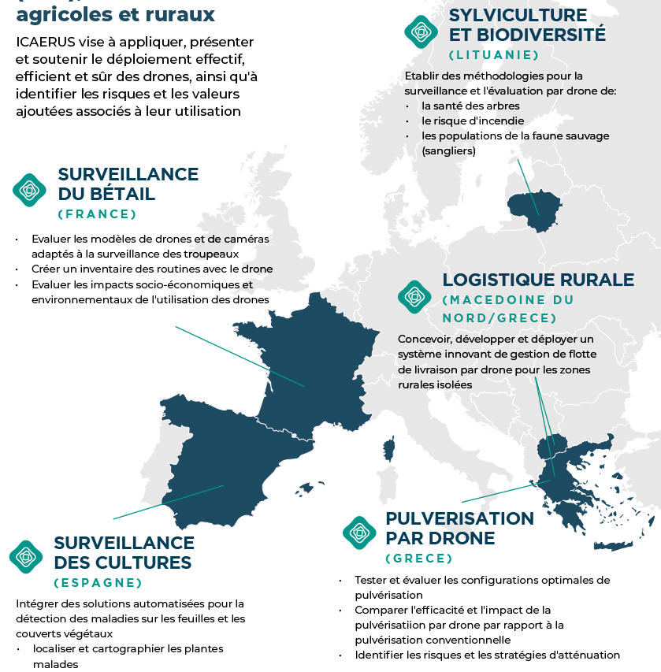
A diverse range of use cases
ICAERUS aims to apply, showcase and support the effective, efficient and safe deployment of drones, as well as to identify the risks and the added value associated with their use.
5 main use cases
Around 20 other uses tested across Europe

Slide 8
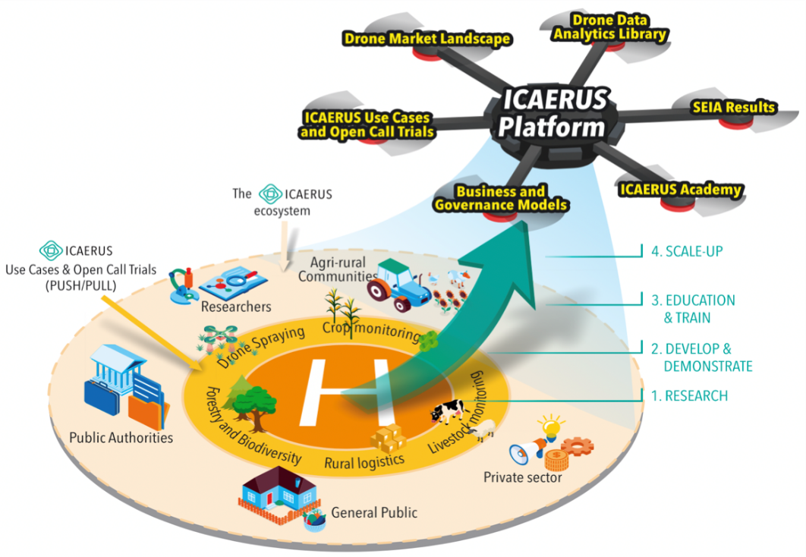
What is being developed?
A library of Artificial Intelligence models and data (open source)
Decoding the “landscape” of the drone world
Studies of the social, economic and environmental impacts of the different uses
Demonstration of different uses
An online training course
Presentations of business models

Slide 9
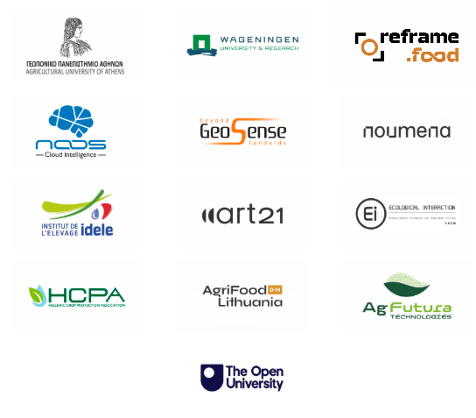
A large team to address all these questions
13 partners from 8 countries
3 European research institutes and universities (AUA, WU, OU)
6 industry players and technology SMEs (GS, NSWR, ART, NMN, EI, AgFutura)
3 non-profit organisations (IDELE, AFL, HCPA)
1 organisation (RFF), expert in maximising impact

Slide 10
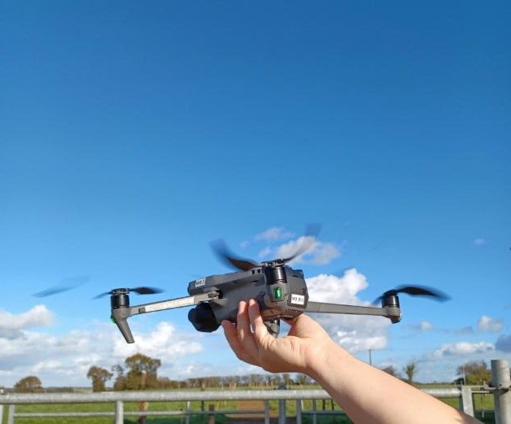
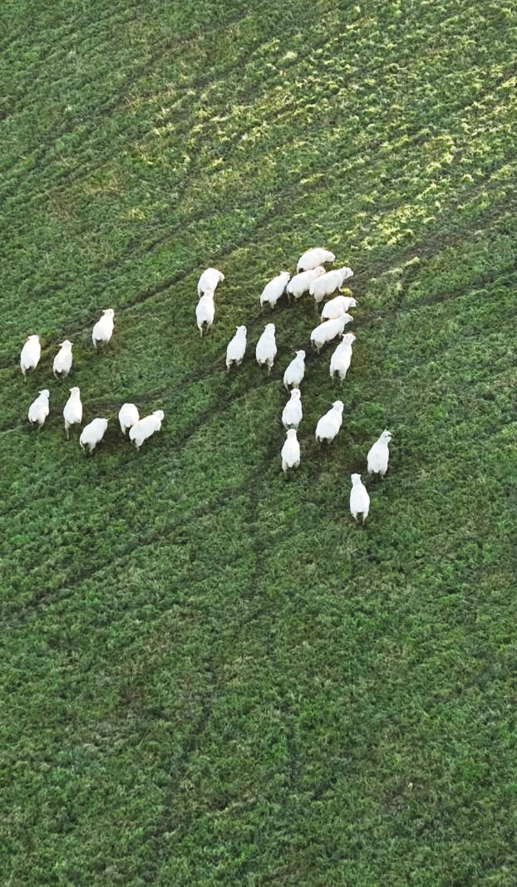
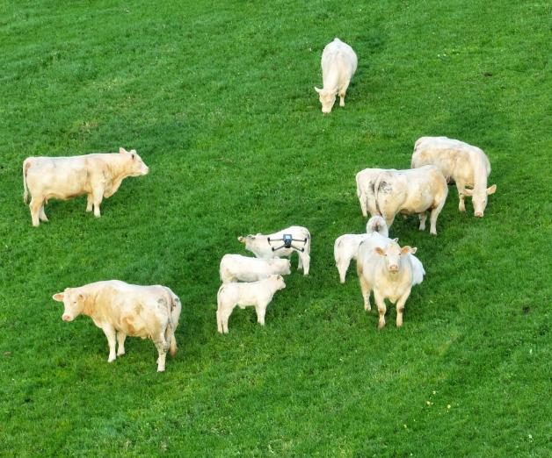
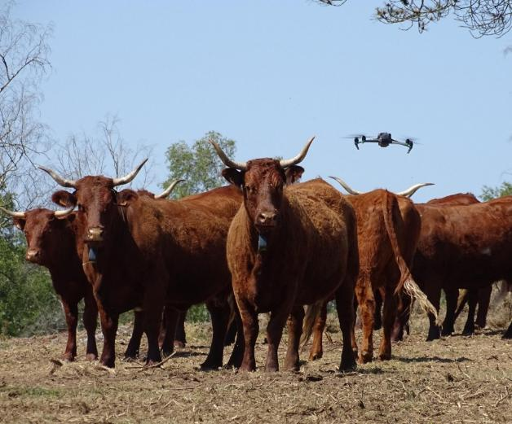
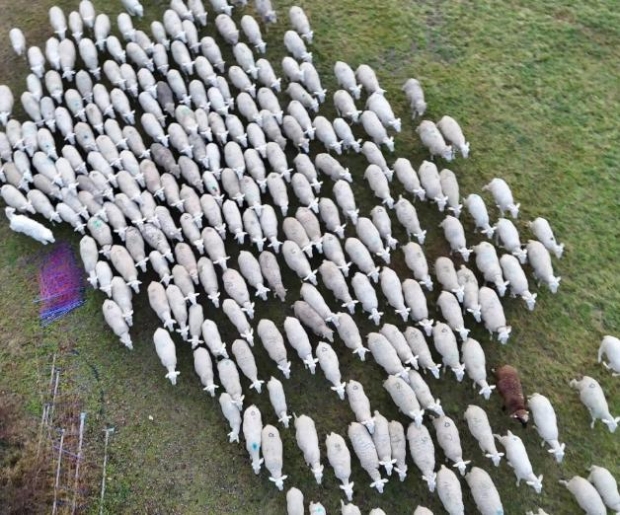

Slide 11
www.icaerus.eu
ICAERUS in France
Drones, to improve the working conditions of livestock farmers for monitoring animals at pasture ?
Technical day: the drone, an aid for monitoring herds
C.I.I.R.P.O | 10 April 2025
Adrien LEBRETON, Estelle NICOLAS
Institut de l’Élevage

Slide 12
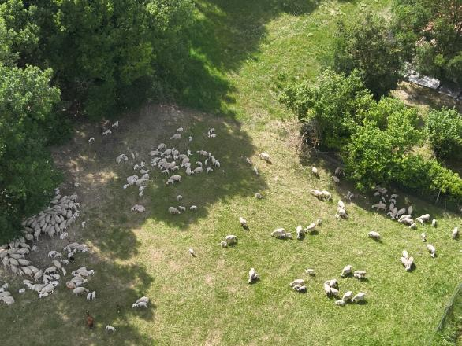
Why take an interest in drones in livestock farming?
8% of livestock farmers in France are equipped with a drone (1)
  19% are considering using one in the coming years (1)
  Use is often too risky
  Difficult to project
  Provide a framework for use that is understandable and adoptable
(1) based on Idele survey 2023, n=2017

Slide 13
Our objectives
Assess les models de drones/of cameras sur for different systems of grassland livestock farming ((beef cattle, & meat sheep)
Create un an inventory of des different uses de drones according to the des systems et to provide un guide suitable advice
Measure the impact de of use des drones sur le travail & Assess the impact economic et and environmental
1
2
3

Slide 14


Our methodology
To assess the risks & benefits of using drones
Exchanges with livestock farmers, researchers and professionals in the drone field through surveys, phone calls or demonstrations
Project
Purchase and deployment of drones: Testing of 5 drones on 3 pilot farms in beef cattle and meat sheep (supported by the AgrifoodTEF)
Training including certifications (CATT, A2)
Exchanges with the partners of the project ICAERUS and French professionals

Slide 15
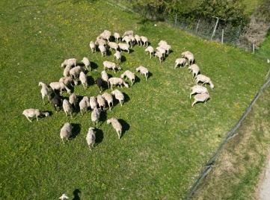
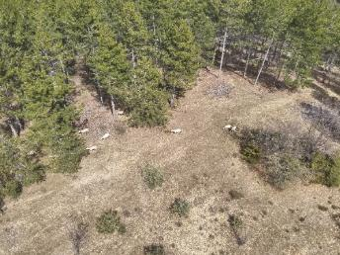
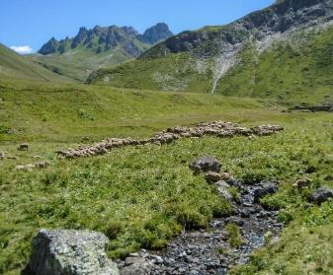
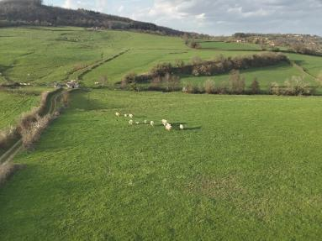
2 pilot farms, 3 landscapes, 2 regions, 2 species
Testing and data collection
Meadows
Rangeland/hillside
Mountain pasture
Farm of Carmejane (meat sheep)
Alpes de Haute-Provence
Ferm’Innov (Jalogny) (beef cattle)
Saône-et-Loire

Slide 16
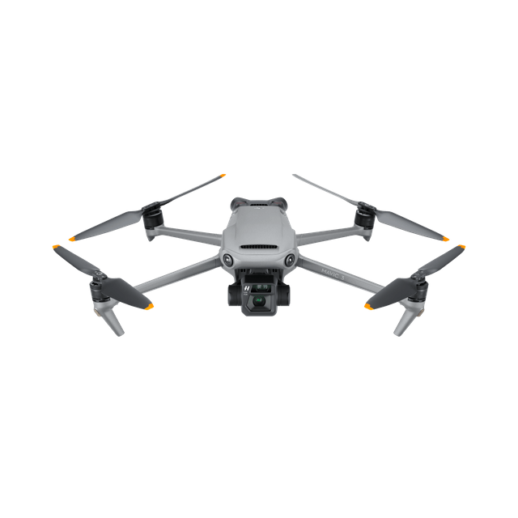
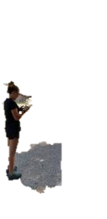

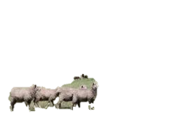
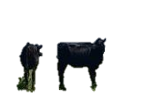

What framework for using drones in livestock farming?
How to choose the drone?
What regulations apply?
The drone and its environment
Being a pilot

Slide 17
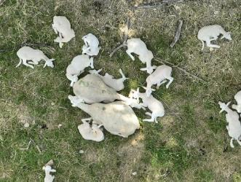
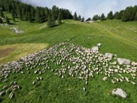
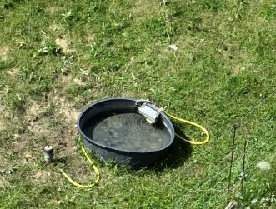
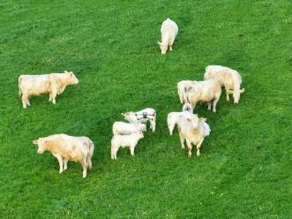
What uses for drones in livestock farming?
Locating animals in distant pastures or hard-to-reach areas
Monitoring animals
Observing the environment
Counting sheep

Slide 18
Data collected for the labour, environmental and economic assessment
Quantitative
  Time recorded for each activity
  Energy consumption
  Qualitative
  Interviews on the experience of using drones: appeal, mental load, skills…

Slide 19






Programme
Welcome - 09:30
Introduction
Testimonial workshops
  [FermInov] : The drone, the farmer’s ally for optimising the management of suckler cattle at pasture.
  [Carmejane] : Is the drone suited to my sheep farm?
  [CIIRPO] : The drone for monitoring sheep flocks and testing other uses.
  Meal provided
Aorkshops and demonstrations
Demonstrations of 5 models of drones
Workshop: Count the ewes without falling asleep thanks to artificial intelligence
Workshop: How could your SME fund its AI and drone innovations?
Wrap-up of the day – Ends 16:00
Bonus: Visit to the Mourier site for those interested
In collaboration with:

Slide 20
The programme
9:30-10:00 – Welcome coffee
10:00-10:20 - Introduction :
  ICAERUS in Europe + general intro: Drones to improve life in rural areas, with varied use cases AL – 8’
  ICAERUS in France : to what extent can drones improve the working conditions of livestock farmers for monitoring animals in grassland areas? EN – 7’
  Questions – 5’
10:20-11:50 - Testimonial workshops
  [FermInov] : “The drone, the farmer’s ally for observing suckler cattle on grass.” - 20’ + 10 questions
  [Carmejane]: “Is the drone suited to my farm?” 20’ + 10 questions
  [CIIRPO] : “The drone, a new tool for observing sheep and an experimental platform.” 20’ + 10 questions
11:50-12:30 - Mini training/information
  Presentation of the practical guide “Drones in livestock farming: opportunities, risks and good practices.” & online academy demo AL – 10’
  Labour assessment EN/AL – 20’
  Questions - 10’
Lunch break – 12:30 /14:30 catering------------------------------------------------------------------------------------------- During lunch – Demonstration of ICAERUS resources
Technical demonstrations: drones suited to farmers or to advanced experiments. (walk-around)
  14:30 – 15:15 Group workshop - In-flight demo
  14:45-15:30 Workshop A - Ground demo : AI stand (Count sheep without falling asleep, thanks to artificial intelligence)
  14:45-15:30 Workshop B - drone stand
  14:45-15:30 Workshop C - TEF stand: a scheme to fund the development of AI in agriculture
15:30-16:00 [All] Wrap-up of the day - return of questionnaires
16:00 - CIIRPO visit (for volunteers)

Slide 21
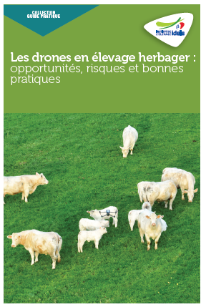
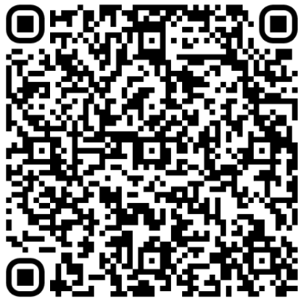
Drones in grassland livestock farming: opportunities, risks and good practices
Practical guide available free of charge

Slide 22
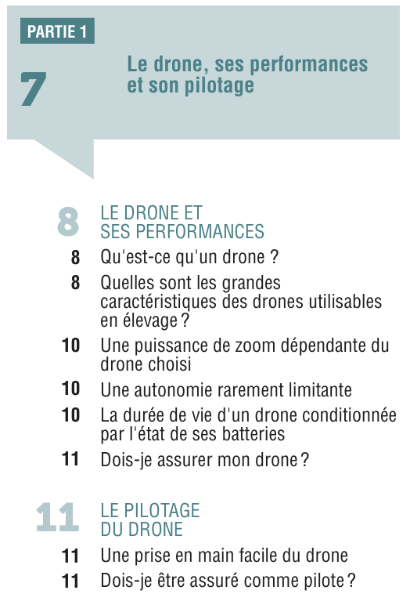
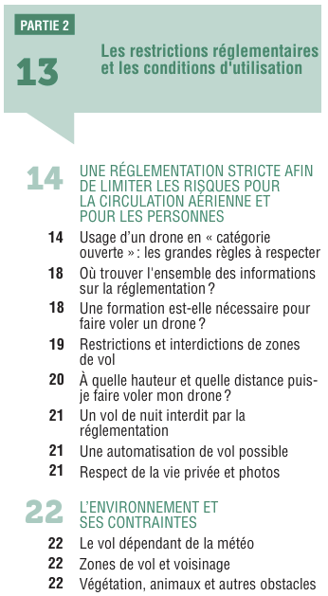
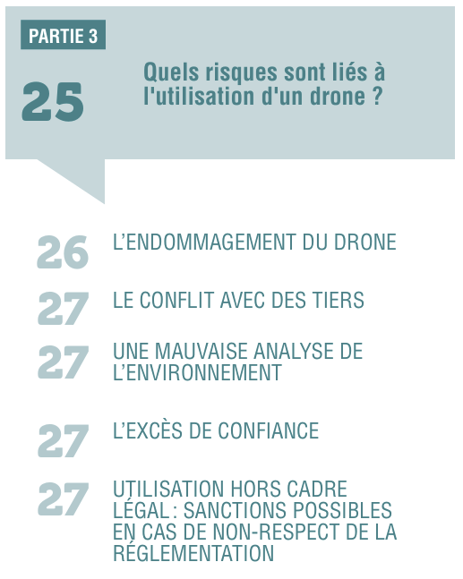
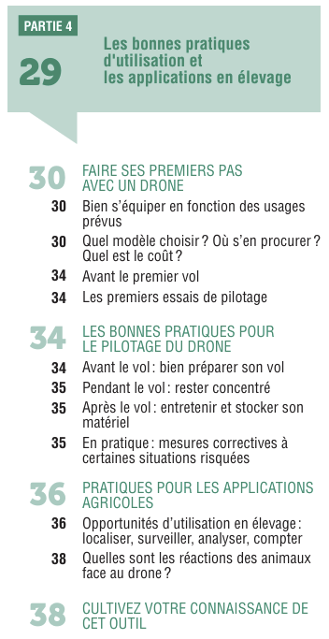
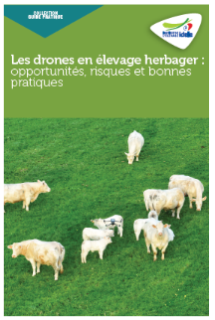

Slide 23

www.icaerus.eu
Labour assessment & evaluation de socio-economic-
environmental -footprint
Technical day: the drone, an aid for monitoring herds
C.I.I.R.P.O| 10 April 2025
Adrien LEBRETON, Estelle NICOLAS
Institut de l’Élevage

Slide 24
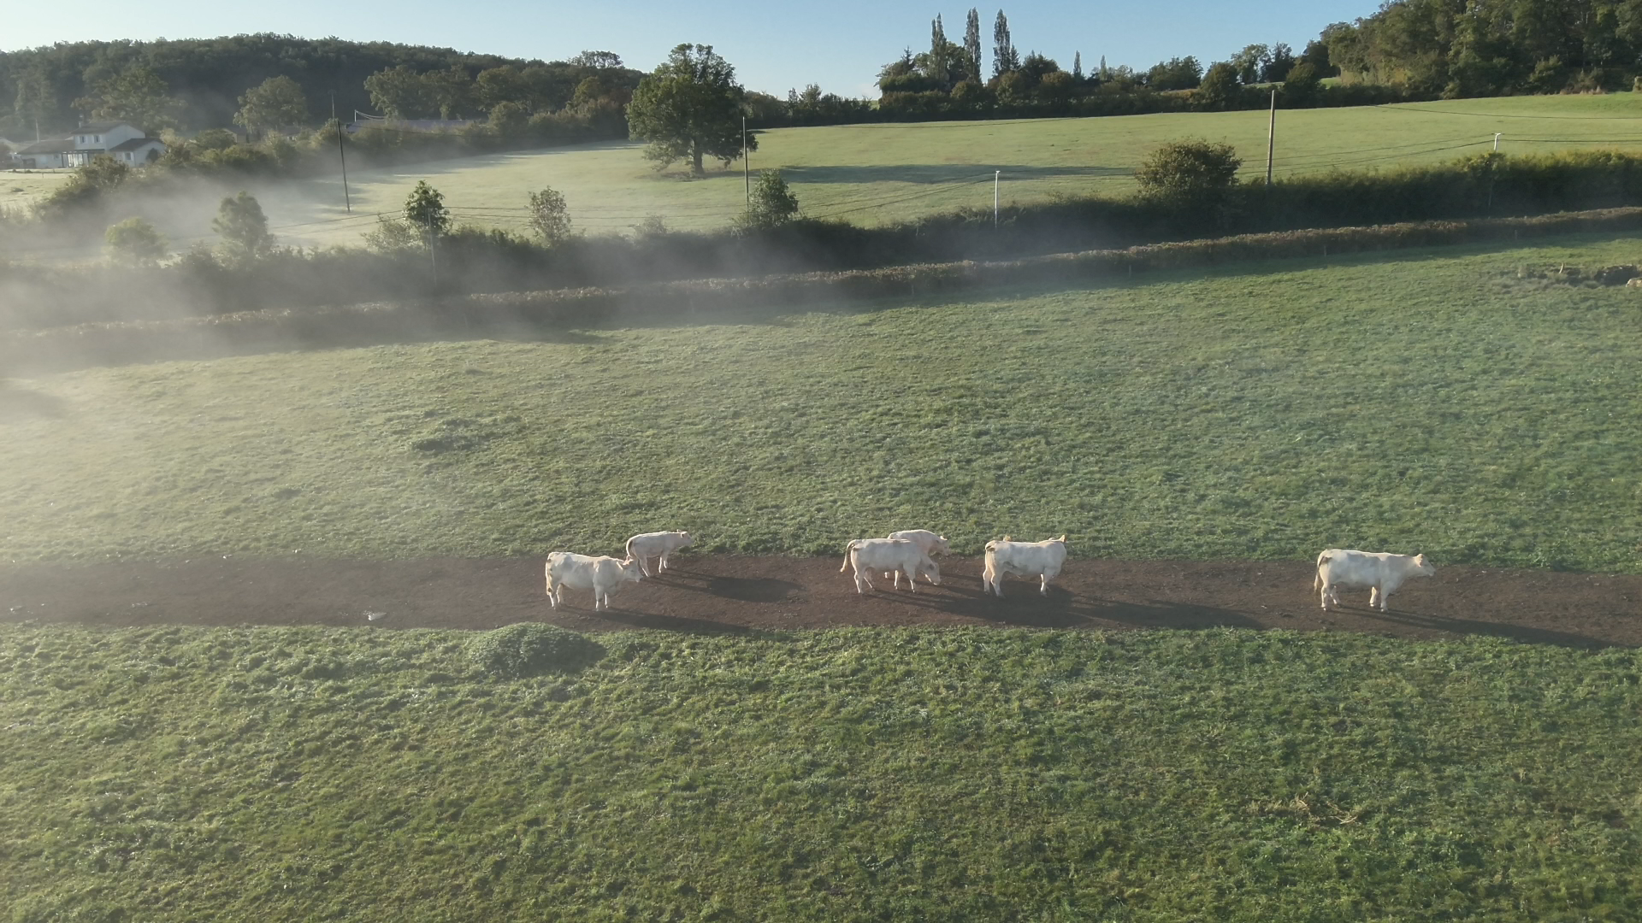
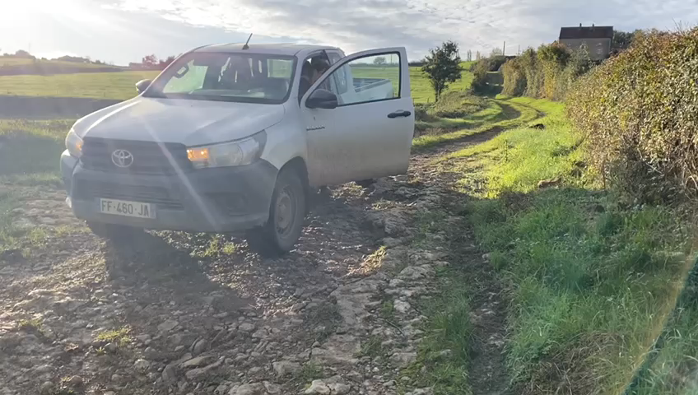
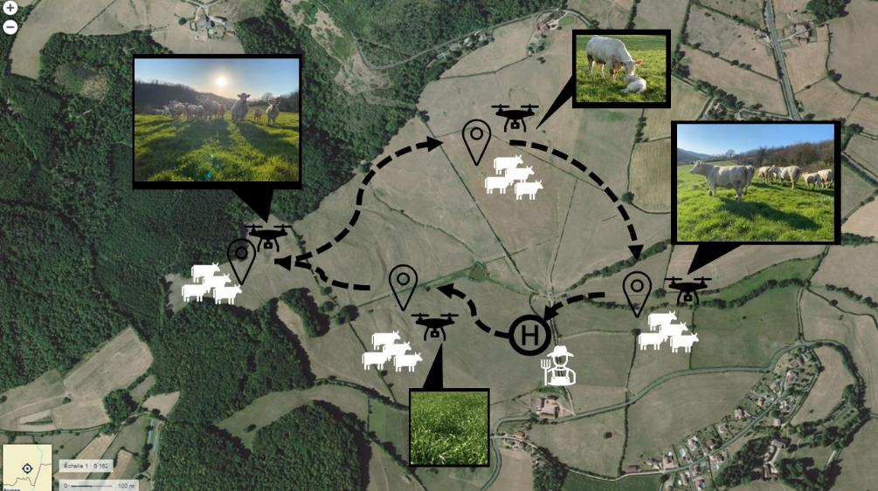
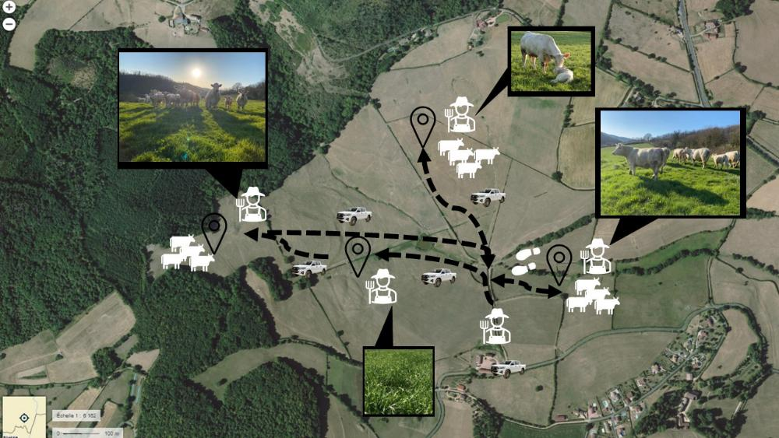
Measuring the impact of drone use on labour
Measuring daily working time (pasture round)
Drone
VS
Conventional
24
Notes:
Objectif & méthode
Données quanti : temps de travail enregistré & Données quali : interviews sur le ressentis de l’utilisateur de drone : attractivité, charge mentale, compétences…

Slide 25
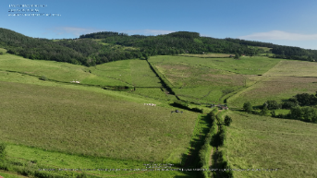
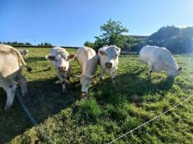
Spring at Ferm’Inov
Autumn at Ferm’Inov
P
A
B
P
P
Car stop
P
zoom
H
Drone take-off
H
P
H
P
P
P
P
Plots grouped within the flight zone
Many groups of animals to visit
Plots grouped within the flight zone
Few groups
Working time with drone
Working time without drone
Working time with drone
Working time without drone

Slide 26
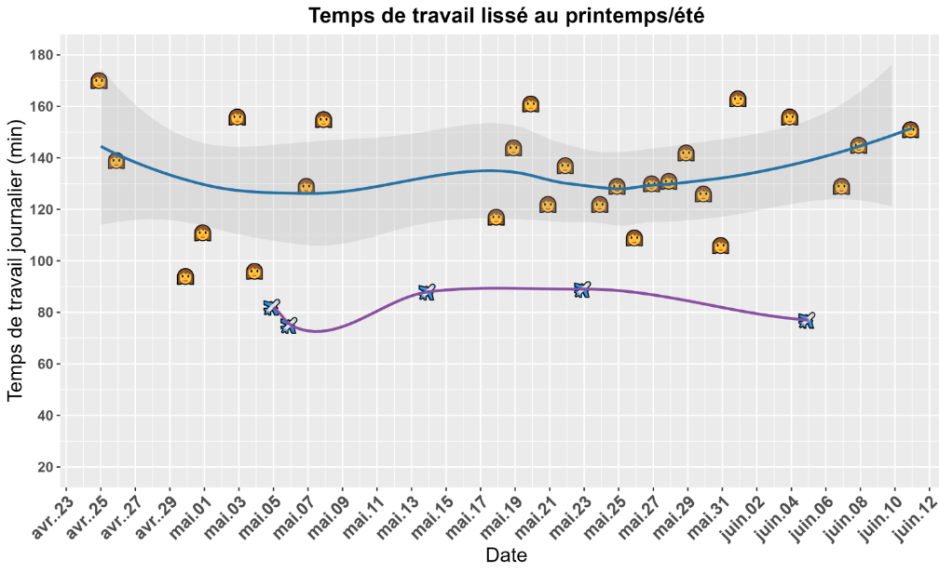
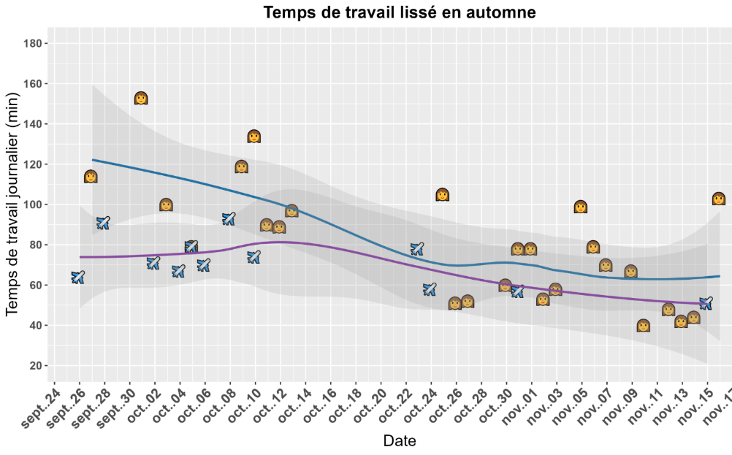

What results?
✈
Drone system
👩
Traditional system
B
Avg = 133 min
Avg = 81 min
Avg = 82 min
38 %
12 %
Avg = 71 min
A
Autumn : difference of 9’46 (12 %)
Spring : difference of 51’16 (38%)
Reduction in working time
Variability
Farmers’ practices (grass quality, number of groups, animals, etc.)
Day-to-day uncertainties

Slide 27
Spring at Ferm’Inov
Autumn at Ferm’Inov
P
A
B
P
P
Car stop
P
H
Drone take-off
H
P
H
P
P
P
P
Plots grouped within the flight zone
Many groups of animals to visit
Plots grouped within the flight zone
Few groups
Working time with drone
Working time without drone
Working time with drone
Working time without drone

Slide 28
What is the benefit of using the drone routinely in my system?
Routine use of the drone
Human intervention needed
No human intervention needed
Plots grouped/accessible
Plots not grouped/hard to access
Many groups to visit
Few groups
Technical constraints
Setting up
Fencing, feed distribution…
Is drone use possible?
Relations with neighbours?
Environmental constraints?
Regulations?
Voltac ?
[…]
-
+++
A
++
B
+

Slide 30
Title
Content

Slide 31










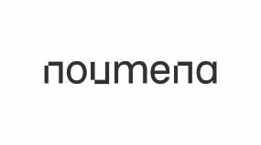

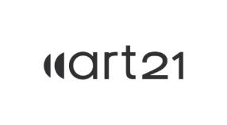





icaerus.eu
icaeruseu
THANK YOU
icaerus-eu
Name Surname | Affiliation
e-mail
icaeruseu

Slide 32
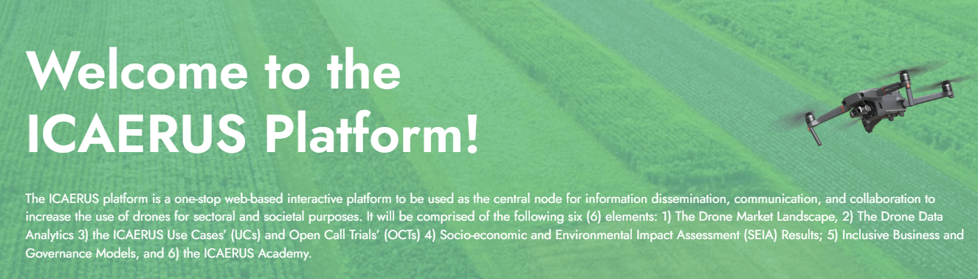
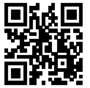

A web platform to access all the project results
https://www.platform.icaerus.eu/
An online academy to learn more about drones

Slide 33

An online academy to learn more about drones
ICAERUS Academy

