Slide 1

Farming smarter, not harder
Γιώργος Παπαδόπουλος
Υπ. Διδάκτορας – Ερευνητικός συνεργάτης
gpapadopoulos@aua.gr
06 Νοε. 2025 – ICAERUS EVENT

Slide 2

Εν συντομία:
Title: Transforming pruning in small-scale agriculture for improved productivity and better working conditions through Augmented Reality (AR) and Robotics.
Grant Agreement Number: 101182739
Project start: 1 February 2025
Duration: 60 months
Partners: 11 organisations from Spain, Finland, Italy, Germany, Greece, Ireland and the United Kingdom
Open Calls: €690,000, 2 calls (M32 and M44)Αριθμός Χρηματοδότησης (Grant Agreement): 101182739
Έναρξη έργου: 1 Φεβρουαρίου 2025
Διάρκεια: 60 μήνες
Εταίροι: 11 οργανισμοί από Ισπανία, Φινλανδία, Ιταλία, Γερμανία, Ελλάδα, Ιρλανδία και Ηνωμένο Βασίλειο
Open Calls: 690.000 €, 2 προσκλήσεις (Μ32 και Μ44)

Slide 3



Τι είναι το AgRimate?
It was designed to:
Enhance efficiency in agriculture.
Improve working conditions for smallholder farmers.
Strengthen mutual support networks through the integration of advanced technologies.
Key Technologies
Augmented Reality (AR) for real-time guidance.
Robotics to automate high-intensity tasks.
Artificial Intelligence (AI) for maximum accuracy and adaptability.
Main Objective
To transform the pruning process — a critical activity for maintaining the health, productivity, and longevity of crops like the olive and vine.

Slide 4
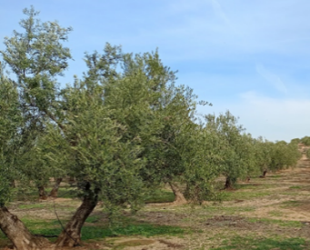
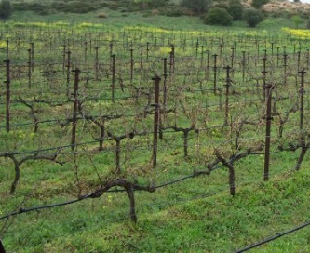
Αντιμετώπιση Γεωργικών Προκλήσεων
Olive groves
The highly variable morphology of trees requires tailored automation technologies.
Centuries-old trees with varying growth patterns pose unique pruning challenges.
Vineyards
The uniform deployment along the support wires offers a structured environment for automated pruning.
It facilitates the integration of Artificial Intelligence (AI)-based systems to identify optimal pruning points.
Why these crops?
They have significant economic and cultural value in the targeted areas.
They provide an opportunity to demonstrate the scalability of technologies in different agricultural environments.

Slide 5
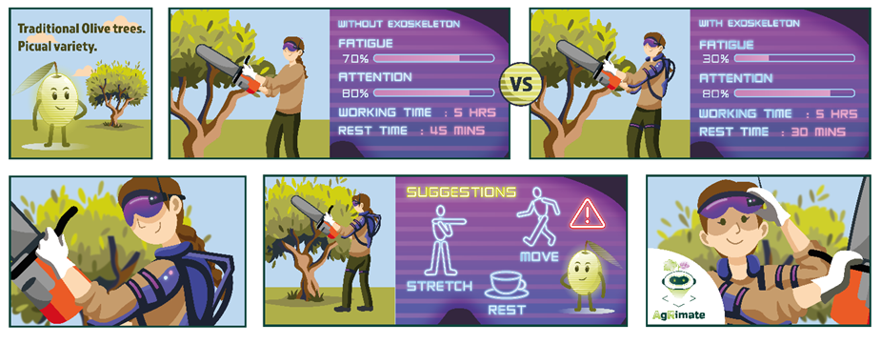
AgRimate in Traditional Olives Pilot

Slide 6
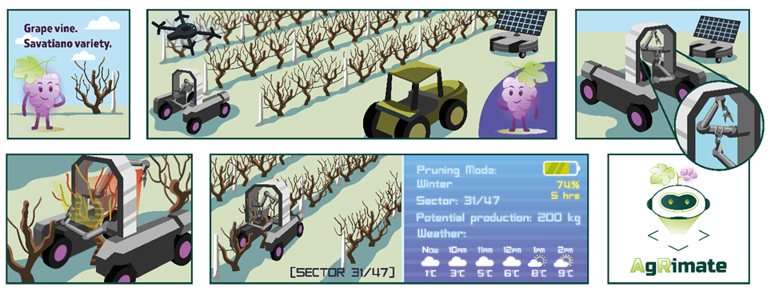
AgRimate in Vineyards Pilot

Slide 7
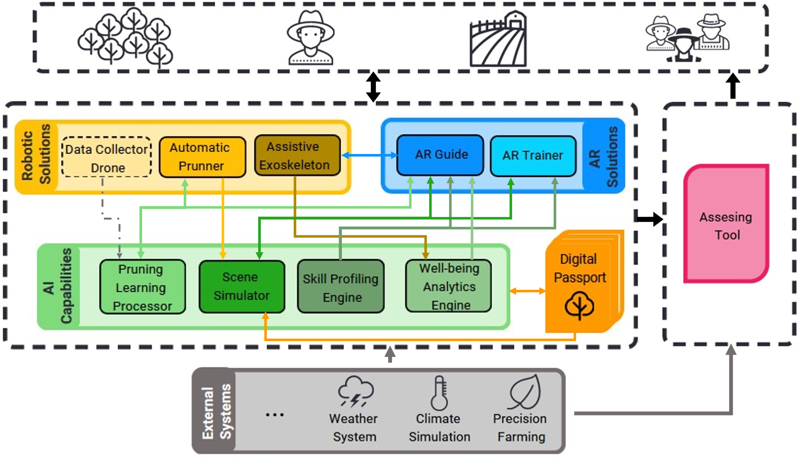
Η Λύση
A Symbiotic Digital Assistant
It reduces physical and time requirements for farmers.
It incorporates training programs to ensure inclusivity and knowledge transfer.
It promotes accuracy, efficiency, and sustainability in farming practices.
Expected Impact
It redefines traditional farming practices, reducing physical strain and increasing productivity.
It introduces scalable automation solutions for pruning, offering benefits to both farmers and the environment.

Slide 8












The Partners
TECNALIA (TEC)
Tampere University (TAU)
Humboldt-Universität zu Berlin (UBER)
Fondazione Bruno Kessler (FBK)
Agricultural University of Athens (AUA)
Technische Universitat Berlin (TUB)
Xymbot Digital Solutions
Robotnik Automation
IUVO SRL
UPA
UPA Jaén
F6S EU Tech Innovation Network

Slide 9
Thank you!
agrimate-project.eu

